Slide 1
I/4. Useful Python efficiency techniques
Data Analyst Intermediate – PYTHON-based Data Analysis, Data Cleaning, Data Visualization & Predictions
Data Analyst Intermediate
Trainer: Szabolcs Jobbagy

Slide 2
Useful keyboard shortcuts – in any mode
Shortcut Key | Description
Ctrl+Enter | run selected cell/cells
Shift+Enter | run a cell and jump to the cell below it (if there is no cell below it, insert one)
Alt+Enter | run cell and insert cell below
Shortcut Key | Description
Ctrl+Tab | jump between browser tabs
Ctrl+S | Save
Ctrl+Z | Undo
Ctrl+Y | Redo/Repeat
Ctrl+Shift+P | command palette, command search

Slide 3
Useful keyboard shortcuts – in Edit mode
Shortcut Key | Description
# | write a comment (on a separate line or at the end of a program line)
Ctrl + / | change program line to comment (and back)
Home | jump to the beginning of the program line
End | jump to the end of a program line
PgUp or Ctrl+Home | jump to the top of a cell
PgDown or Ctrl+End | jump to bottom of cell
Shift + Down or Up | select program lines down / up
Ctrl+Shift+Minus | split the cell at the cursor position
Ctrl+D | delete program line
Tab | automatic completion of commands
Shift+Tab | element description / tooltip of element where our cursor is
CTRL + mouse click | Add multiple cursor (ESC to stop it)

Slide 4
Useful keyboard shortcuts – in Command mode
Shortcut Key | Description
A | insert cell above cell
B | insert cell below cell
Shift+Down / Shift+Up | select multiple cells
C | copy selected cells
X | cut selected cells
V | paste below cell
Shift+V | paste above cell
F | find and replace
D, D | delete selected cell(s)
Z | undo cell deletion
Space | scroll down
Shift+Space | scroll up
Shortcut Key | Description
Shift+M | merge selected cells, merge 1 selected cell with the one below it
M | change entire cell to "markdown"
Y | change cell back to executable code
Shift+L | show/hide line numbers
O | show/hide the result (output) below the cell
Shift+O | scroll / not scroll output
I, I | interrupt kernel
0, 0 | restart kernel (values of variables are lost)
H | show shortcut keys

Slide 5


Handling dates
Start a new notebook
A date in Python is not a data type of its own, but we can import a module named "DATETIME" to work with dates as date objects
strftime(format): formats dates into readable strings
import datetime as dt # import module handling dates and times
birth_date = dt.date(2020, 3, 21) print(birth_date)
print(birth_date.strftime("%x")) # local date print(birth_date.strftime("%Y")) # year full print(birth_date.strftime("%m")) # month number print(birth_date.strftime("%B")) # month full name print(birth_date.strftime("%d")) # day as number (1-31) print(birth_date.strftime("%A")) # day full name print(birth_date.strftime("%w")) # weekday as a number (0-6), 0 is Sunday
today_date = dt.datetime.now() today_date

Slide 6
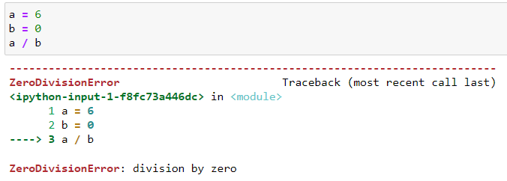
Catching errors (TRY – EXCEPT)
If we misspell anything in the code or we want to do an incorrect operation, we'll receive an error message
We can "catch" the error and do something in case of error
try: (requires a colon at the end)
Here you can put instructions starting with TAB
except: (requires a colon at the end)
Here, also beginning with TAB, what happens in case of an error
pass: do nothing
try: print('The quotient is ' + str(a / b)) except: print('We cannot divide by zero!')

Slide 7
Asking the user to input data (INPUT)
input(…): We can request data or parameters from the user, and the code will continue to run according to what the user entered
We can check if the value is a number with a TRY-EXCEPT block: if float() runs on an error, then it is NOT a number
n = input('Type a number: ')
n = input('Type a number: ') try: print('The number squared:', float(n) ** 2) except: print('Type a NUMBER, not a text!')

Slide 8
Creating and deleting folders in file system
os.mkdir: create a folder (the "OS" module is required) If it already exists, it gives an error -> use TRY - EXCEPT
os.rmdir: delete folder (only if empty)
shutil.rmtree: delete folder with all files in it ("SHUTIL" module)
import os, shutil basepath = r'…' subfolder = 'Test folder'
# create folder (if it does not exist) try: os.mkdir(basepath + '\\' + subfolder) except: pass # do nothing
# delete folder (if empty) try: os.rmdir(basepath + '\\' + subfolder) except: pass # do nothing
# delete folder with all files in it shutil.rmtree(basepath + '\\' + subfolder, ignore_errors = True)

Slide 9
Deleting files from file system
os.remove: delete a file (only if it is not currently open in an application)
outputfolder = "Output" # delete file (if it is not open) os.remove(basepath + '\\' + outputfolder + '\\' + 'All_tables.xlsx')

Slide 10
Notifications with beeping sound
We can play sounds with the "WINSOUND" module
Beep(frequency, duration): plays a sound with a given frequency and duration
It's useful at the end of a program's run, or in case of an error, it notifies the user
import winsound # Windows sound playing module
# beep sound frequency = 840 # Hz duration = 1000 # milliseconds winsound.Beep(frequency, duration)

Slide 11
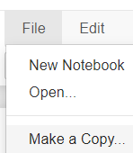
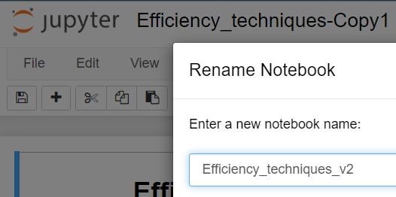

Copying notebooks
File menu - Make a Copy: copy a notebook
Copy the "Efficiency_techniques" notebook
Then click on its name and rename it
In the folder we can also copy the notebook, select it by clicking the checkbox, the Duplicate button
Delete notebook

Slide 12
I/5. Creating custom Functions
Data Analyst Intermediate – PYTHON-based Data Analysis, Data Cleaning, Data Visualization & Predictions
Data Analyst Intermediate
Trainer: Szabolcs Jobbagy

Slide 13


Defining custom functions (def)
Start a new notebook
def functionname(parameter1, parameter2, …): (colon needed) define a custom function (instructions indented with TAB)
text = 'Jack Bauer' # from start until space text[ : text.find(' ') ]
text = 'Jack Bauer' # from after space until the end text[ text.find(' ') + 1 : ]
# define function: reverse first name and surname def reversed_name(text): return text[ text.find(' ') + 1 : ] + ' ' + text[ : text.find(' ') ]
# call the function reversed_name('Jack Bauer')

Slide 14
Measuring runtime
„TIME” module: a module for handling times
time.time(): gives the current time
import time # module for handling times # start time starttime = time.time()
# define function: measure runtime def runtime(start, end): hour, remainder = divmod(end - start, 3600) minute, second = divmod(remainder, 60) return 'Runtime: {:0>2}:{:0>2}:{:05.2f}'.format(int(hour), int(minute), second)
endtime = time.time() # write out runtime – call function runtime(starttime, endtime)

Slide 15
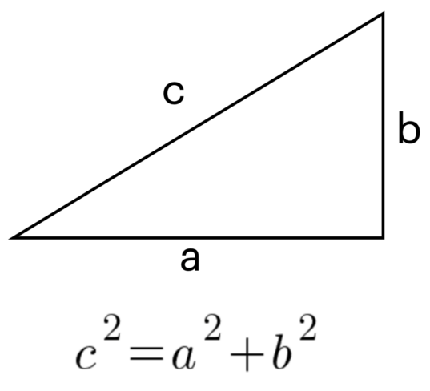
Custom LAMBDA functions
lambda parameter(s): formula specifying a short, one-line custom function
# define function: reverse first name and surname reversed_name = lambda text: text[ text.find(' ') + 1 : ] + ' ' + text[ : text.find(' ') ] # call the function reversed_name('Jack Bauer')
# define function: calculate hypothenuse from the legs of right-angled triangle pythagoras = lambda a, b : (a ** 2 + b ** 2) ** (1 / 2) # call the function pythagoras(3, 4)

Slide 16
Rounding numbers
round(number, decimals): rounds the number
The „MATH” module makes mathematical calculations easier
math.floor: rounds the number DOWN to integer
math.ceil: rounds the number UP to integer
# define function: calculate hypothenuse from the legs of right-angled triangle # rounded to 2 decimal digits pythagoras2 = lambda a, b : round( (a ** 2 + b ** 2) ** 0.5, 2 )
import math # import the math module
# define function: calculate hypothenuse from the legs of right-angled triangle # rounded DOWN to integer pythagoras3 = lambda a, b : math.floor( (a ** 2 + b ** 2) ** 0.5 )
# define function: calculate hypothenuse from the legs of right-angled triangle # rounded UP to integer pythagoras4 = lambda a, b : math.ceil( (a ** 2 + b ** 2) ** 0.5 )

Slide 17
I/6. Conditionals (IF) and Loops
Data Analyst Intermediate – PYTHON-based Data Analysis, Data Cleaning, Data Visualization & Predictions
Data Analyst Intermediate
Trainer: Szabolcs Jobbagy

Slide 18

Conditional (IF) 1.
Start a new notebook
if ……: (need a colon at the end) the instructions must be indented with TAB
else: (need a colon at the end) the instructions must be indented with TAB
Equal (as comparison): ==
Not equal (as comparison): !=
a = 5 # if a is EQUAL to 5 if a == 5: print('True') else: print('False')
a = 5 # if a is NOT EQUAL to 5 if a != 5: print('True') else: print('False')

Slide 19
Conditional (IF) 2.
Nesting multiple IF's ->
elif ……: (need a colon at the end) the instructions must be indented with TAB
a = 4 if a % 2 == 0: print('Can be divided by 2') elif a % 3 == 0: print('Cannot be divided by 2, but can be divided by 3') else: print('Cannot be divided by either 2 or 3')
a = 6 b = 8 # if … else … in one program line (shorthand) print('They are equal') if a == b else print('They are NOT equal')
# AND relation if a == b and b != 0: | # OR relation if a == b or b == 0:

Slide 20
Searching for texts with IF
We can use IF for searching for substrings within text
a = 'Jack Bauer' # if text contains substring if a.find('Jack') >= 0: print('Contains') else: print('Does not contain')
a = 'Jack Bauer' # if text contains substring if 'Jack' in a:
# if text contains substring (not case sensitive) if 'jack' in a.lower():
a = 'Jack Bauer' # if text starts with substring if a.startswith('Jack'): print('Starts with it') else: print('Does not start with it')
a = 'Jack Bauer' # if text ends with substring if a.endswith('Jack'):

Slide 21
Binary variables (True or False)
If a variable is assigned the value True or False (should start with Capitalized letter), it becomes a binary variable ("boolean" data type)
# binary or boolean variable (True/False) v = True # If v is True if v: print('v is True') else: print('v is False')
# binary or boolean variable (True/False) v = True # If v is NOT True (False) if not v: print('v is False') else: print('v is True')

Slide 22
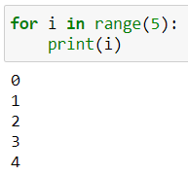
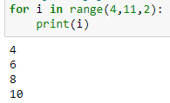
Loops (FOR)
for …… in ……: (need a colon at the end) the instructions must be indented with TAB
Iterates/loops through all the items, repeats the instructions for each of them
i: traditional name of an index (counter) variable
# loop through integers from 0 to 4 (endpoint not included) for i in range(5): print(i)
# loop through integers from 4 to 10, by 2 (endpoint not included) for i in range(4, 11, 2): print(i)

Slide 23

Loops (WHILE) 1.
while ……: (need a colon at the end) the instructions must be indented with TAB
It repeats the instructions until the variable reaches a value (while it is equal to / less than / grater than…)
Increasing/decreasing a variable value:
i += 1: increase the variable value by 1
i -= 1: decrease the variable value by 1
i = 1 # repeat the instructions while i <= 5 while i <= 5: if i % 2 == 0: print(str(i) + " even") else: print(str(i) + " odd") i += 1

Slide 24
Loops (WHILE) 2.
We can use WHILE loops for the "input" (asking the user for an input data)
If the user enters a valid value (e.g. a number), then continue the program, otherwise repeat the data inquiry again and again
if type(n) == int or type(n) == float: check if it's a number
valid = False # repeat the following while 'valid' is false while not valid: n = input('Type a number: ') # try to convert it to numeric try: n_numeric = float(n) valid = True except: print('Type a NUMBER, not a text!') print( f'The number squared: {n_numeric ** 2}' )

Slide 25

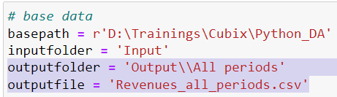
Looping through files in a folder
Start new notebook, and paste base data without inputfile, outputfolder and outputfile changes
Create output folder (if it does not exist)
for …variable… in folder: loops through all files in the given folder
Add a beep sound, write out runtime and a final message
If we run this, after cleaning Source1.csv, it will clean Source2.csv as well, and OVERWRITES the output file, so we lose the cleaned Source1 data
# import necessary modules import pandas as pd, os, winsound, time # start time starttime = time.time()
# loop through all files in folder for inputfile in os.listdir(basepath + '\\' + inputfolder): %run Read_csv.ipynb %run Clean_data.ipynb df_export = df %run Export_to_csv.ipynb

Slide 26
Appending multiple files into one Dataframe
We can create 1 Dataframe from all tables: create an empty dataframe, loop through the files, append each to this dataframe
df.append(new_df, ignore_index = True) (it is deprecated!) pd.concat([df, new_df ], ignore_index = True): append new dataframe to dataframe
the 1st parameter is a LIST with the dataframes to concatenate
ignore_index = True: do not transfer the indexes
We create an empty dataframe: df_main
We loop through all the files in folder
Read_csv imports the inputfile's data into df
We append each df to the df_main
After we have imported all files and concatenated them into 1 dataframe (df_main), we store this df_main in df, so that we can continue working with the short 'df' variable
# create an empty dataframe df_main = pd.DataFrame() # loop through all files in folder for inputfile in os.listdir(basepath + '\\' + inputfolder): %run Read_csv.ipynb # append the dataframe to the main dataframe df_main = pd.concat([df_main, df], ignore_index = True) df = df_main
%run Clean_data.ipynb df_export = df %run Export_to_csv.ipynb

Slide 27
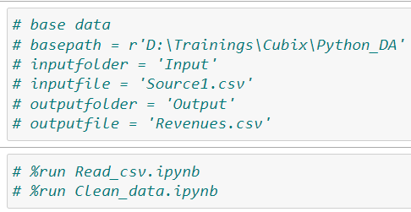
Creating dimension tables from multiple files
We create the dimension tables as well from all source tables
In the "Create_dimension_tables" program convert these parts to comment and save the notebook
Then in "Clean_multiple_files" we can run that program as well
%run Create_dimension_tables.ipynb

